Slide 1
Hitachi Vantara
Pentaho Cyber Security for xxxxxx
Me, Solution Engineer

Slide 2

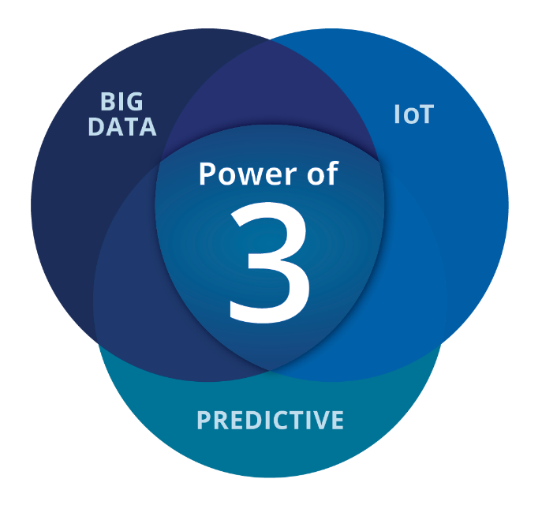
Hitachi Vantara Advantage
Deep expertise in deriving value from big data
Focused on IoT
COE & Best practices
Smart Cities, Industry and Energy
Hitachi Labs
Deep bench of data scientists
Vertical and domain expertise
Notes:
Pentaho is a subsidiary of Hitachi, a 90 billion conglomerate most recently #79 on Fortune’s Global 500 list.
Pentaho was acquired as a cornerstone of Hitachi’s strategic big data analytics business
Analytics engine driving Hitachi’s IoT initiative to power smart cities, smart industry and smart energy
Hitachi provides digital transformation solutions to transform businesses in the 3 areas of Big Data, IoT and Predictive Anlytics.
http://beta.fortune.com/global500/list

Slide 3


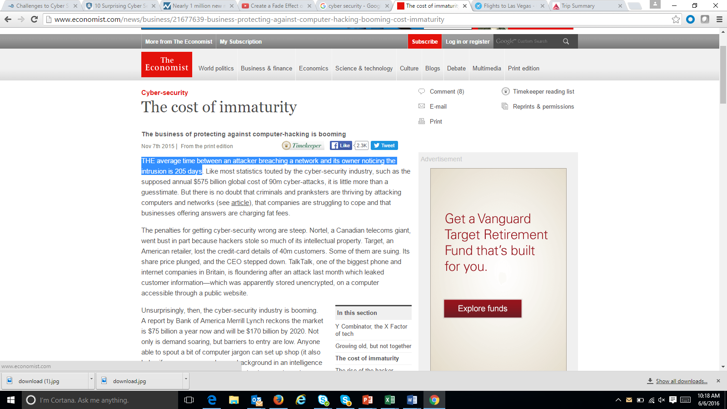
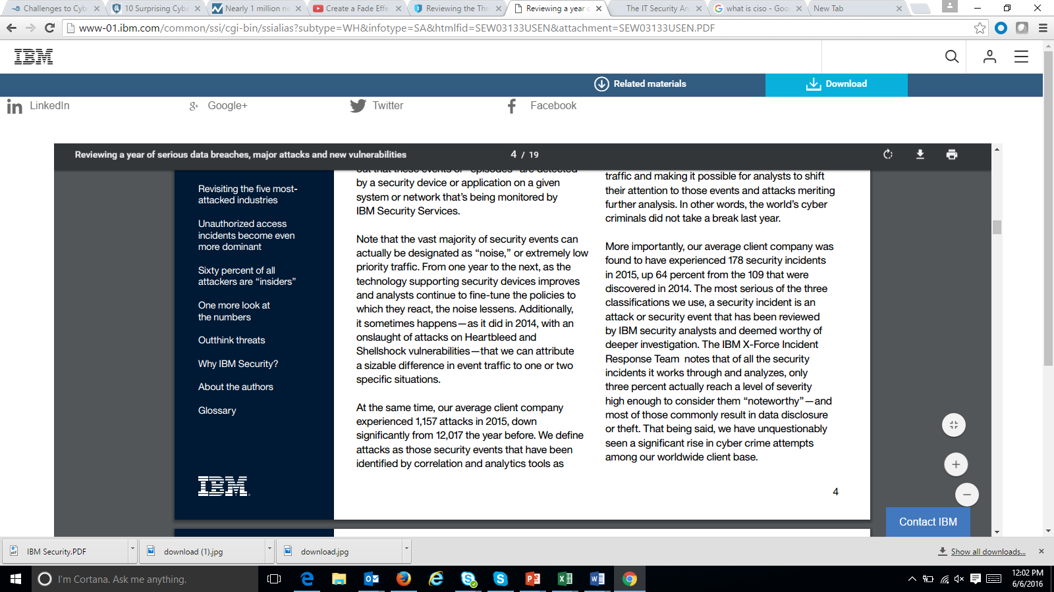
The Challenges of Cyber Attacks
“2 Billion records stolen in the first half 2017”
“50% of all the risks faced by an organization were attributable to phishing”
CISO FORUM 2016
“The average time between an attacker breaching a network and its owner noticing the intrusion is 205 days”
45% of most frequent incidents are unauthorized access of which 60% of the attackers are “insiders”
Notes:
The 1 Million New Cyber Threats per Day quote - http://money.cnn.com/2015/04/14/technology/security/cyber-attack-hacks-security/
http://www.economist.com/news/business/21677639-business-protecting-against-computer-hacking-booming-cost-immaturity
https://securityintelligence.com/ciso-forum-2016-what-is-keeping-cisos-awake-at-night/
http://www-01.ibm.com/common/ssi/cgi-bin/ssialias?subtype=WH&infotype=SA&htmlfid=SEW03133USEN&attachment=SEW03133USEN.PDF

Slide 4
Cyber Security - Accelerating
Notes:
The 1 Million New Cyber Threats per Day quote - http://money.cnn.com/2015/04/14/technology/security/cyber-attack-hacks-security/
http://www.economist.com/news/business/21677639-business-protecting-against-computer-hacking-booming-cost-immaturity
https://securityintelligence.com/ciso-forum-2016-what-is-keeping-cisos-awake-at-night/
http://www-01.ibm.com/common/ssi/cgi-bin/ssialias?subtype=WH&infotype=SA&htmlfid=SEW03133USEN&attachment=SEW03133USEN.PDF

Slide 5
Cyber Security Popular Trends
The Business of Compromising Data & Machines
‘Living off the Land’ – attack existing installed software via fileless attacks
In-Memory DLL/Registry/PowerShell/Script/Macro execution
Common in Linux via Python, Perl & Bash (server/mobile/IoT)
Ransomware like WannaCry is fileless
CryptoCurrency-Mining Malware
Don’t collect BitCoin from hostages – mine it instead
More popular than Ransomware now (Source: MalwareBytes)
The switch to crypto took only 6 months between June-Dec 2017
In 2018, 50% of all enterprise malware attacks use SSL (Source Gartner)
Most common attack vectors: spear-phishing emails, social engineering
Most successful attacks use multi-layer/step obfuscation
Net Takeaway: Attacks now require behavioral analysis to be discovered

Slide 6
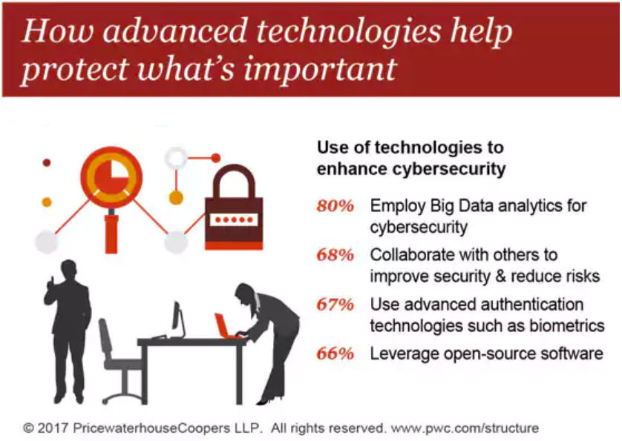
Cyber Security Trends
The Emerging Role of Big Data Analytics

Slide 7
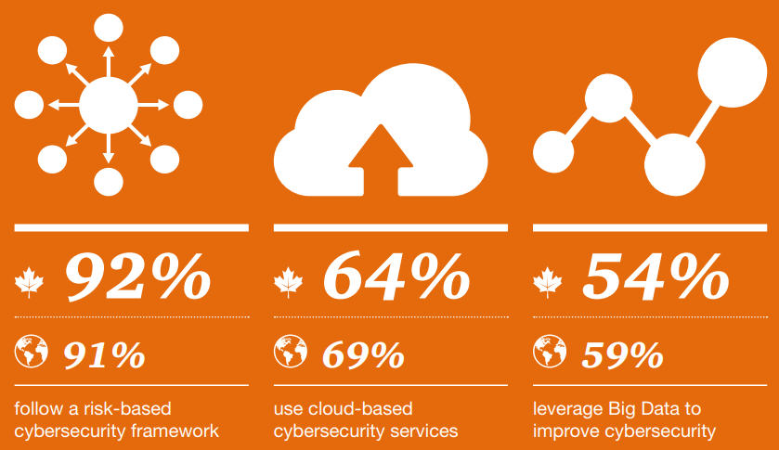
Cyber Security Trends - Canada
The Emerging Role of Blended Analytics
Source: PWC - The Global State of Information Security – Canadian Insights

Slide 8
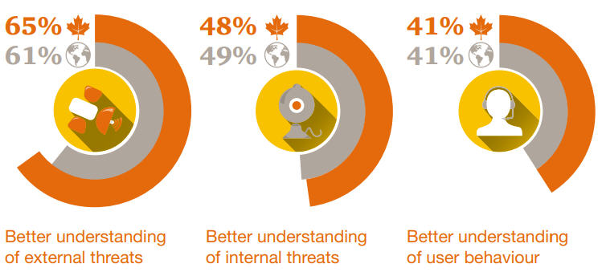
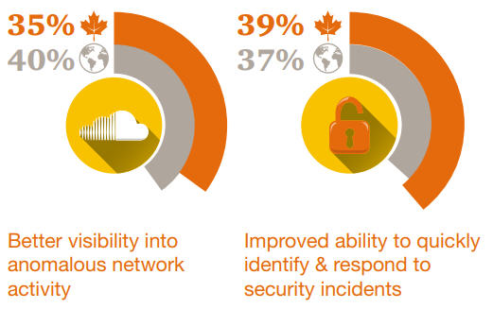
Cyber Security Trends - Canada
Benefits of Big Data Cyber Analytics
Source: PWC - The Global State of Information Security – Canadian Insights

Slide 9




Cyber Security Through Logs
A Big Data Problem
# of Log entries per Day
64.8 M Logs
21.6 M Logs
21.6 M Logs
1.4K Logs
4.3K Logs
1 log created every minute
3 different types of logs
Analyze logs from 5K PCs
Analyze logs from 5K mobile devices
Collect logs from 3K machines from 5 data centers
Over 100M logs per day!
Over 21 Billion logs in 205 Days!
Notes:
A log is an accounting record of what happened in a machine or an application through time. It’s one of the better data to analyze cyber intrusion.
Log is a Big Data problem due to the diversity and volume of logs can be recorded in a day. A machine can record a log per minute and can generate 1,440 logs per day. But most company would analyze more than 1 type of log. Sometime 3 applications of logs need to be monitored and that translates to over 4K logs per day.
When the Big Data problem stems from analyzing thousands of PC, thousands of mobile devices and even thousands of machines from 5 different data centers, the volume of logs can be generated from hundreds of millions per day to billions of logs if it takes 205 days to detect cyber intrusion.

Slide 10
Cyber Security – In addition to logs
Unstructured Data
Source : IDC, The Digital Universe, Dec 2012
Notes:
Log is Semi-Structure because the structure part is only time-stamp, IP address, standards for vlog. But most of it is unstructured. This explains why the unstructured part is growing.
Most Unstructured Data are:
Social Media Data with Personal Credit Card Information
Geo-Location (semi-structured and unstructured) – where is the credit card been used
Emails with attachments and links to bad list of URLs

Slide 11
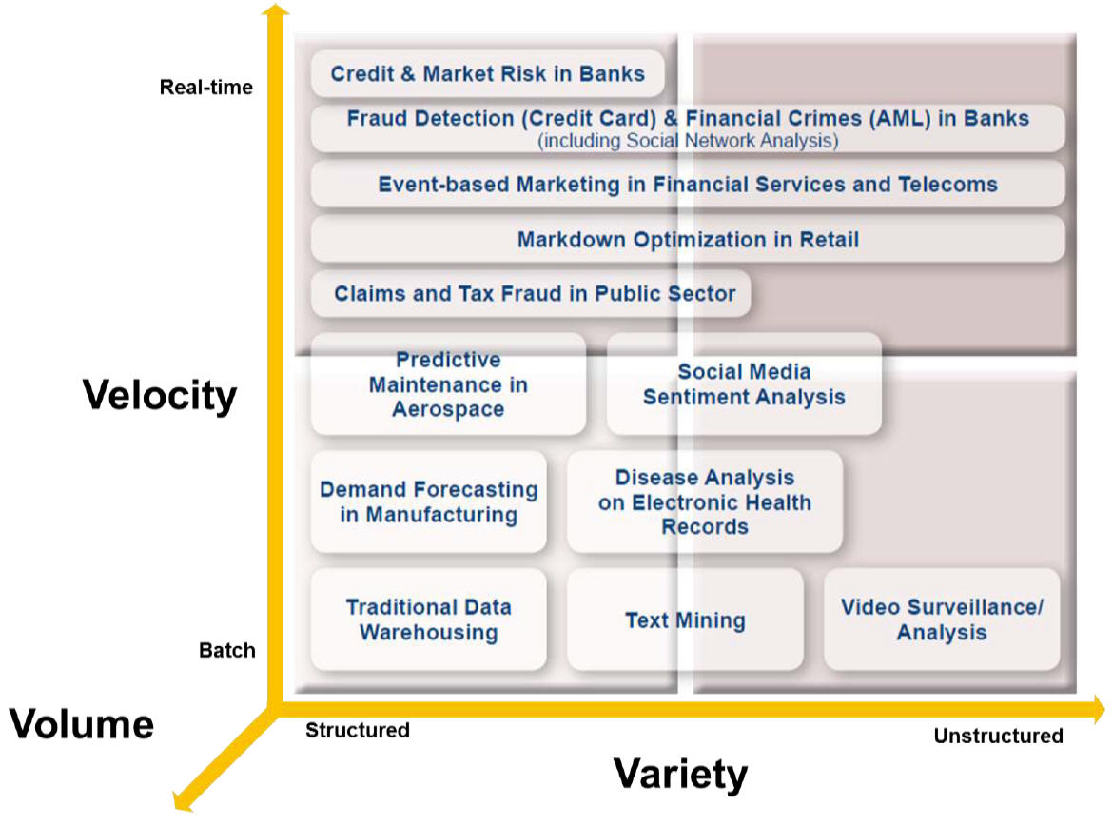
Cyber Security – Time to Detection
Where We Want to Be
Big Data Enables Accelerated Analytics
Cyber Analytics
Source: IDC
Notes:
Log is Semi-Structure because the structure part is only time-stamp, IP address, standards for vlog. But most of it is unstructured. This explains why the unstructured part is growing.
Most Unstructured Data are:
Social Media Data with Personal Credit Card Information
Geo-Location (semi-structured and unstructured) – where is the credit card been used
Emails with attachments and links to bad list of URLs

Slide 12
Cyber Security
The Complexity of a Big Data Problem
Internal
Blend Data at Scale
External
Server
Network
Internet
IPR Systems
CRM & ERPS Systems
User Lists
Compromised Websites
Known Phishing Senders
Geo Location
Social Media
In order to do Behavior Intrusion Analysis,
you need to blend data at scale to get 360 degree cyber attack view.
Notes:
Next gen cyber security systems – Logs, structured, unstructured semi-structured data from internal and external sources
Ability to scale to petabytes
Blend all data sources at scale and making it ready for correlation across desperate sources.
Ability to setup automated alerts

Slide 13
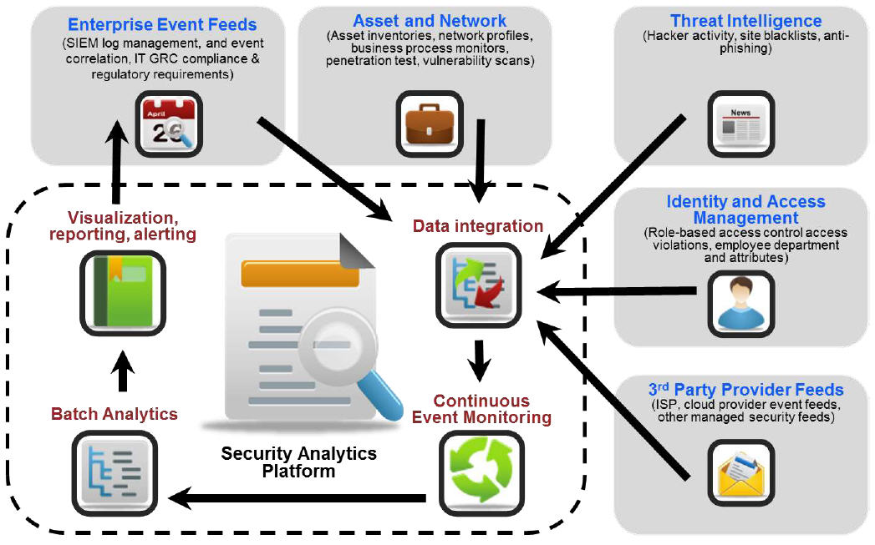
Cyber Security 360 – Blending Feeds
The Role of Data Integration
Cyber Security - Current Landscape and Future Challenges - Anish Mohammed, Lead Security Architect, Lloyds Bank Group
Notes:
Pentaho automatic Meta Data Injection and support MapReduce allow customer to leverage the data lake using Hadoop or NoSql. The parsing and meta data management is the hardest part of data lake process and Pentaho can automate this process for you
In addition to bringing data to the data lake. It’s also important to take advantage of Advanced Analytics in the process by integrating algorithms in Hadoop to help detect cyber intrusions and potential threats
We can also blend data from SIEM, HCM and External Watchlist for Cyber Security 360 view.

Slide 14

Why Pentaho Cyber Security Analytics?
Automate preparation, blending, reporting and alerting of complex variety of data
Fill some of the resource gaps through automation
Integrate predictive analytics for near real time behavioral analytics
Reduces complexity without the deep cost to deploy, maintain and operate.

Slide 15


Blend Logs and Business Data with 360 view - Cyber Security Investigating
LDAP
Automated Onboarding
Sophos
Hadoop Cluster
Data Integration
Analytic DB
Web Logs
PDI in cluster processing
R, Python Weka
Cyber SecurityAnalytics
On-Demand Integration & Blending
Data Integration
Employees or Outsiders
Existing
ETL Tool
or Pentaho
SIEM
Existing ETL Tool or PDI
Data Marts
BI Tools
External WatchList of URL sites
EDW
Notes:
Pentaho automatic Meta Data Injection and support MapReduce allow customer to leverage the data lake using Hadoop or NoSql. The parsing and meta data management is the hardest part of data lake process and Pentaho can automate this process for you
In addition to bringing data to the data lake. It’s also important to take advantage of Advanced Analytics in the process by integrating algorithms in Hadoop to help detect cyber intrusions and potential threats
We can also blend data from SIEM, HCM and External Watchlist for Cyber Security 360 view.

Slide 16
Greatly improve analysis time
Months to Never
Logs, Tweets, CRM, Geo data, etc
Parse Logs & Enrichment
In-line Analytics
Alerting
InteractiveAnalytics
Security & Governance
Reporting
Simplified by Pentaho Cyber Security Analytics
Security & Governance
Automated
Automated
Automated
Automated
Automated
Automated
Hours to Minutes
Notes:
Log ingestion, unstructured, semi-structured and unstructured is just bringing the data from a data source into Pentaho.
Parse Logs is doing meta data injection. Enrich the data is blending data like employee, geo-location, device, etc….
Advanced Analytics is leveraging Weka to do intrusion behavior and anomaly detection.
Once an attack is detect, Pentaho can do real time alerting.
Modeling?
Create reports to communicate Cyber Attack activities and analysis to help with decision.
Decision will create better Security & Governance.

Slide 17

Leading Energy Company Use Case
Problem: Internet violation analysis and data processes are Complex Big Data problems. Existing vendor solution was too slow and required lots of scripting
Pentaho’s Solution: Pentaho is able to remove the scripting and automate the data transformation reducing the time from months to minutes
Benefit: Enables faster reporting of intrusion behavior and provides cleansed data for Data Scientist’s advanced analytic algorithms for Cyber Attack Detection

Slide 18

Leading Telecom Company Use Case
Problem: Need to identify first time login user of anything – URL, devices, server, applications.
Pentaho’s Solution: Accelerates the log parsing process in Hadoop and integrates Bloomfilter libraries to automate and alert first time users.
Benefit: First time users reporting is reduced to help the forensic team narrow their cyber threat behavior analysis.

Slide 19

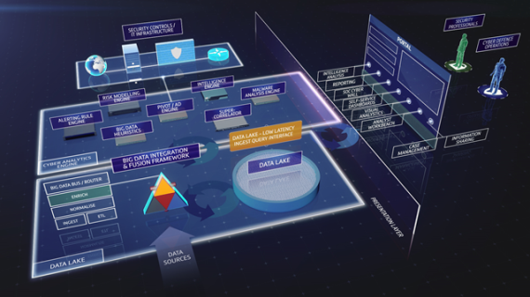
BT: Cyber Security Service Embeds Pentaho for Big Data Blending & Analytics
Business Case
Launch of new service to market: BT Assure Cyber, an enterprise solution for integrating, managing and analyzing all data types with precise insights
Previously BT Assure Cyber could only integrate relational data sources & not big data sources.
Benefits
Every data source is analyzed & acted up upon immediately
Reduced detection time of cyber threats from weeks to seconds
Why Pentaho?
Provides end-to-end data integration and analytics with a metadata approach
Pentaho’s native support for Hadoop in an enterprise environment
Extendibility to address new data threats and Future-proof architecture
Notes:
BT
BT Assure Cyber offers comprehensive and fully integrated cyber security for large organisations with complex security needs including the UK Ministry of Defence and other corporate and government customers. UK Government Communications HQ (GCHQ) and other sources claim cyber breaches cost the global economy hundreds of billions of dollars annually.
Previously BT Assure Cyber could only integrate relational data sources, which meant that its customers’ big data sources were not being harvested to detect potential security breaches. By embedding Pentaho, event data and telemetry from a rich variety of data sources including business systems, sensors, traditional security controls and advanced detection tools are all integrated and analysed. Incidents that previously would have taken days or weeks to investigate and respond to, can now be identified and acted upon immediately.
The Disruptive Insight
BT knew that data variety and unpredictability was a mounting problem, but as an ‘Oracle shop’ with a relational heritage, they could not see an obvious way to solve it – customers all have different data landscapes depending on their individual needs, and BT must cater to all. BT started to tackle this by introducing the Hadoop framework. However, relying on Hadoop’s native, immature tools like Sqoop, Flume, Oozie, Kafka to integrate and analyse the data proved massively difficult, time-consuming and risky
Pentaho convinced BT that its big data integration and analytics platform combined with a metadata approach was the only way to reliably assimilate and blend data from so many different and unpredictable sources. BT recognised that Pentaho’s visual tools provided much faster time to value with lower risk, requiring fewer specialised development resources than native Hadoop tools.
Why the Customer Chose Pentaho
Pentaho’s ability to handle data variety and uncertainty in a range of customer scenarios was central to winning this deal. Pentaho successfully proved its viability and offered references in many other high-stakes, complex and secure customer use cases in industries like financial services and energy.
Getting the Deal Done
The single most important factor was Pentaho’s native support for Hadoop in an enterprise environment. Combined with Pentaho’s commercial flexibility to licence the platform in line with how BT charges its customers – by data volumes ingested – the ROI case finally became too compelling to resist.

Slide 20
Questions

Slide 21
What’s in a (Firewall) Device?

Slide 22
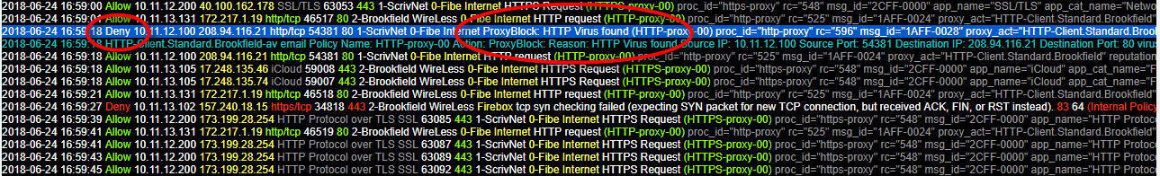
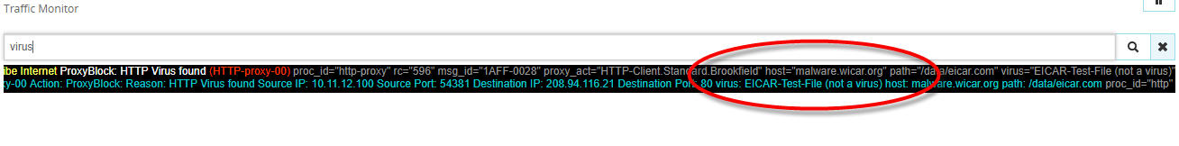
Analyzing Firewall Traffic
Detailed Alert Data is Logged
Common Client Event Header Data
Date Time Result Source IP Target IP Application/Protocol NAT / Port Source/Target Interface Firewall Action (Firewall Policy)
Host & Cause
Data in Key=“Value” Pairs

Slide 23
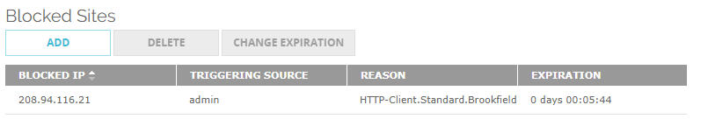
Analyzing Firewall Traffic
Link to Blocked Sites IP’s = Can indicate compromised Clients

Slide 24
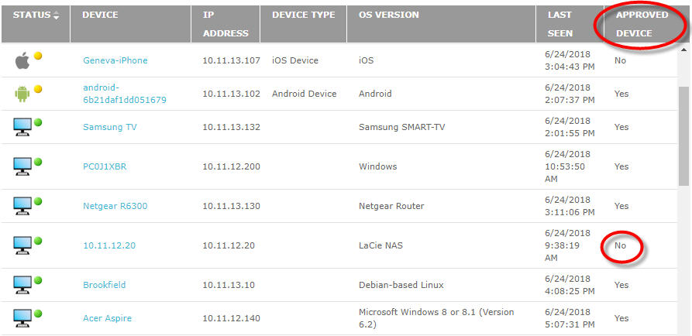
Analyzing a Firewall
Network Device Data

Slide 25
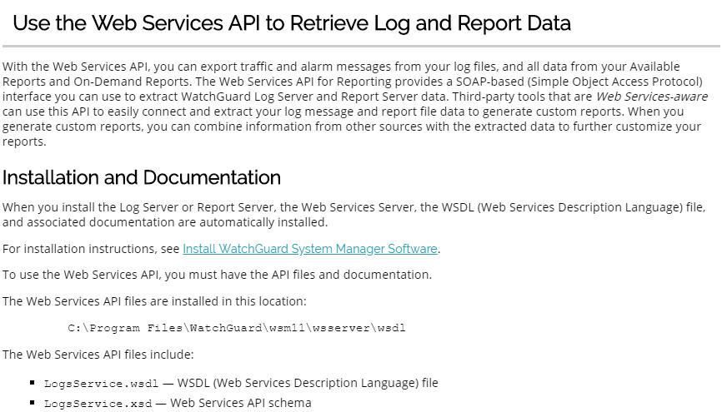
Analyzing a Firewall
Built In API’s for reading the data

Slide 26
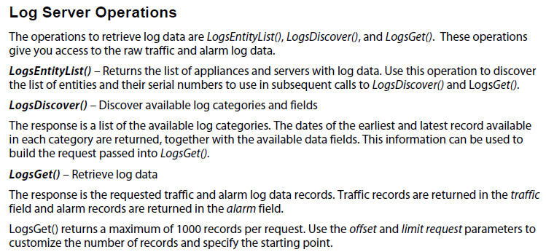
Analyzing a Firewall
Enterprise Firewalls often have centralized Log Operations

Slide 27
Sample Reports

Slide 28
Top Blacklist - Number of Employees Visited Sites
Results of meta data injection and blending of data create meaningful business insight…
Drill Down capabilities and add regions and type of roles (staff, mgr and VPs)
MAC Address | Company Equipment | First Name | Last Name | Login | Day & Time | Title | start date | end date | email address | Region | Function
00:0a:95:9d:68:16 | Unknown | Mike | Lee | mlee | 3/11/2016 12:33 | Director | Mar-12 | 0 | mike.lee@company.com | America | Marketing
00:0a:60:10B:56:1 | Unknown | Unknown | Unknown | iksogy | 1/2/2016 | Unknown |  |  |  | America
Notes:
AD – MAC Address, user name, computer name
HR Database

Slide 29
How many different Devices are entering the Network?
Ability to drill down, figuring out the unknown device and the user name
URL | MAC Address | Company Equipment | Asset # | First Name | Last Name | Login | Day & Time | Title | Region | Status
Bestfriend.com | 00:0a:95:9d:68:16 | Iphone 6s | 100001000999D | Mike | Lee | mlee | 3/11/2016 12:33 | Director | America | Full Time
Bestfriend.com | 00:0a:60:10B:56:1 | Unknown |  | Unknown | Unknown | iksogy | 1/2/2016 16:33 | Unknown | America | Not Employee
Bestfriend.com | 01:0d:10:19C:16:0 | Unknown |  | Unknown | Unknown | shoty | 12/13/2015 0:00 | Unknown | America | Not Employee

Slide 30
Monitoring Virus Attack (Optional)
Slide Bar

Slide 31
Cyber Security Analytics – Data Ingestion

Slide 32
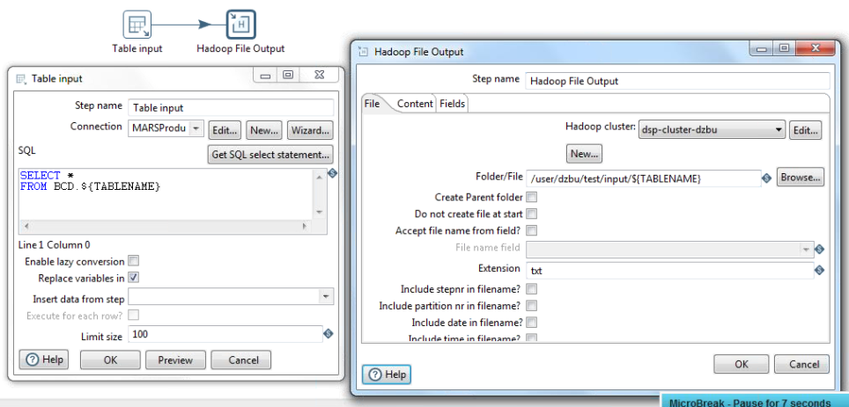
SQL Server to HDFS
Generic, re-usable transformation to copy any SQL Server table to HDFS.
${TABLENAME} parameter is used to determine source and target.
1M records transferred in 1.5 minutes.

Slide 33
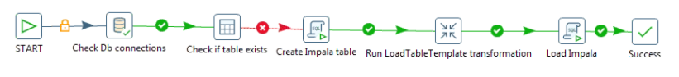
Data Ingestion Workflow
Generic, re-usable workflow for data migration to Impala
Check DB connection is up.
Check if the table exists in Impala and, if not
Run DDL statement to create Impala table
Run transformation template (with ${TABLENAME} parameter) to load SQL server table into HDFS.
Load data into Impala.
The workflow is also parameterized as a generic template so that you can loop over a list of tables and migrate them all to Impala. This can be done in parallel for large migrations.

Slide 34
Cyber Security Analytics – Big Data Processing

Slide 35
Semi-structured log files
Variable and nested data structures
Semi-structured data such as many log files present challenges not found in row/column-based traditional data.
RowHeader key1=val1 key2=val2 key3=val3
RowHeader key2=val2 key1=val1
RowHeader key1=val1 key3=val3 key2=val2
The example above has 3 issues to address:
The row is comprised of two components at a high level: a RowHeader prefix and a set of key/value pairs.
Not all key/value pairs are in each row
The key/values appear in different order.
In addition, new keys may appear in logs after upgrades. These keys should be automatically detected and processed.
Pentaho has specific features to simplify parsing this type of data dynamically.

Slide 36
Semi-structured log file examples
Active Directory events, Sophos anti-virus logs, and Web proxy logs
Active Directory event logs:
<12>Mar 18 23:58:55 146.36.82.32 AgentDevice=WindowsLog AgentLogFile=Security Source=Microsoft-Windows-Security-Auditing Computer=pc1.example.com User= Domain= EventID=1234 EventIDCode=5678 EventType=7 EventCategory=14389 … (additional KEY=VALUE pairs)
Sophos anti-virus:
1427345811234 146.36.80.61 LEEF:1.0|Sophos|Enterprise Console|1.0|Device control - Alert only|cat=EnterpriseConsole devTimeFormat=yyyy-MM-dd HH:mm:ss EventID=4161234 src=111.222.133.144 ComputerName=PC123 domain=MS ComputerID=52123 devTime=2015-05-26 04:52:43 EventTypeID=7 EventTypeName=Device control … (additional KEY=VALUE pairs)
Web proxy logs:
115.26.37.48 MS\jdoe Java/1.7.0_04 - 4/1/2015 0:00 - PC123 - 11.22.33.44 55.22.33.77 8080 - 376 327 http - POST http://11.22.88.77:80/IA/SocketServlet ...

Slide 37
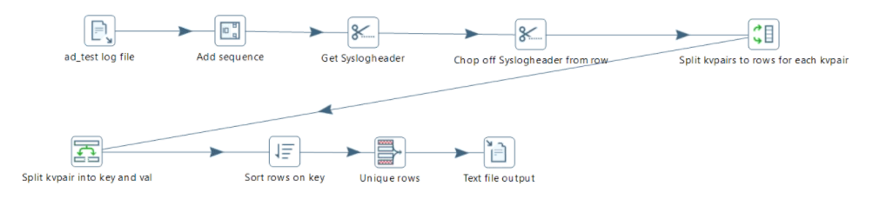
Dynamic Metadata Extraction
Scanning logs to determine metadata
We developed a generic transformation template to scan for all possible keys in a log file.

Slide 38
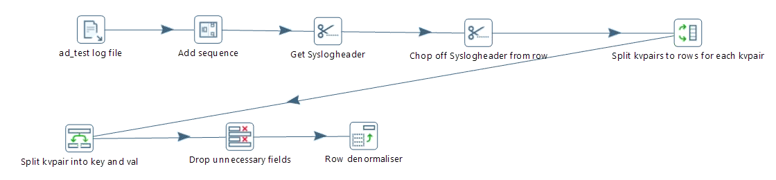
Log Parsing Template
Generic, parameterized template for parsing logs
We developed a generic transformation template for parsing the logs.
The template accepts a list of keys to extract at run-time.
Key/value pairs may vary from row to row
Key/value pairs may appear in any order

Slide 39
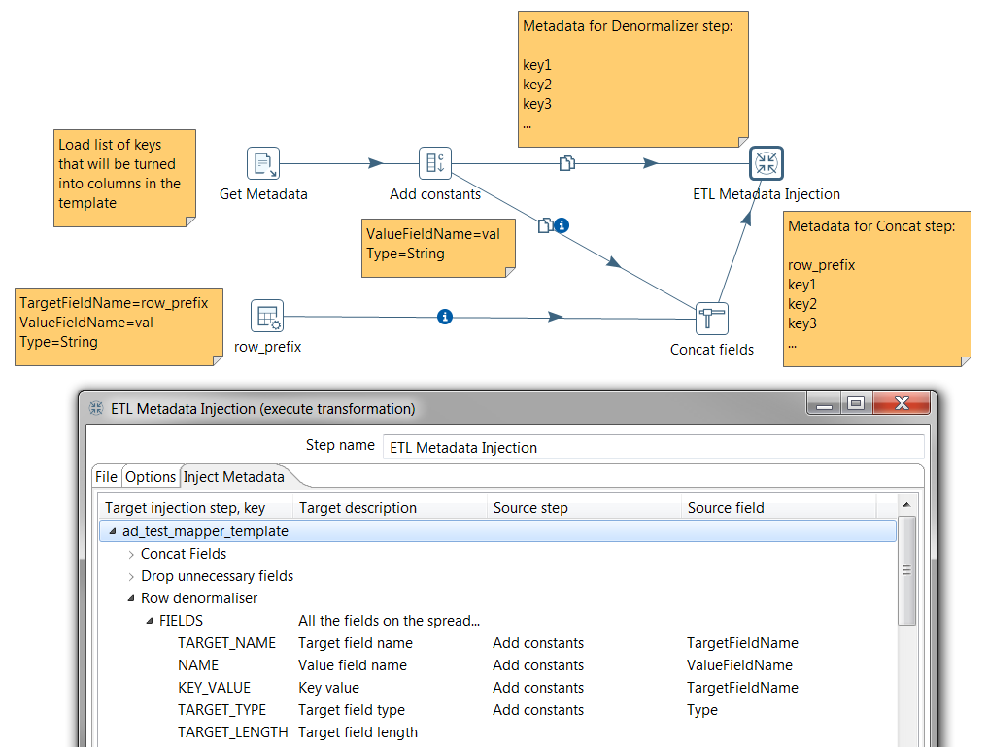
Dynamic Metadata Injection
Inject metadata into a transformation template at run time.
Multiple metadata lists may be injected into the same template for use at different steps within the template.

Slide 40
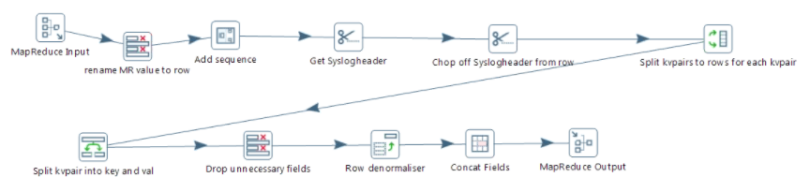
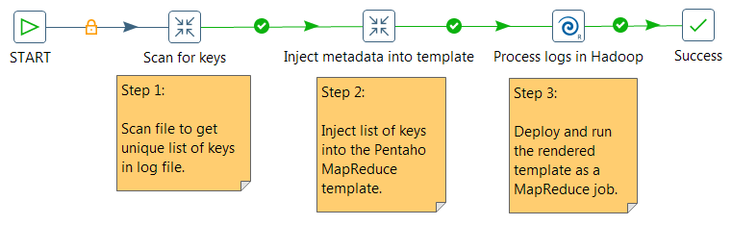
Pentaho MapReduce
We converted the template to run as a Pentaho MapReduce job
Modifying the transformation to run on Hadoop only required changing the end points. All the logic remained the same.
A simple workflow automates the entire process.

Slide 41
Cyber Security Analytics – Business Analytics
Subtitle placeholder
Subtitle placeholder

Slide 42
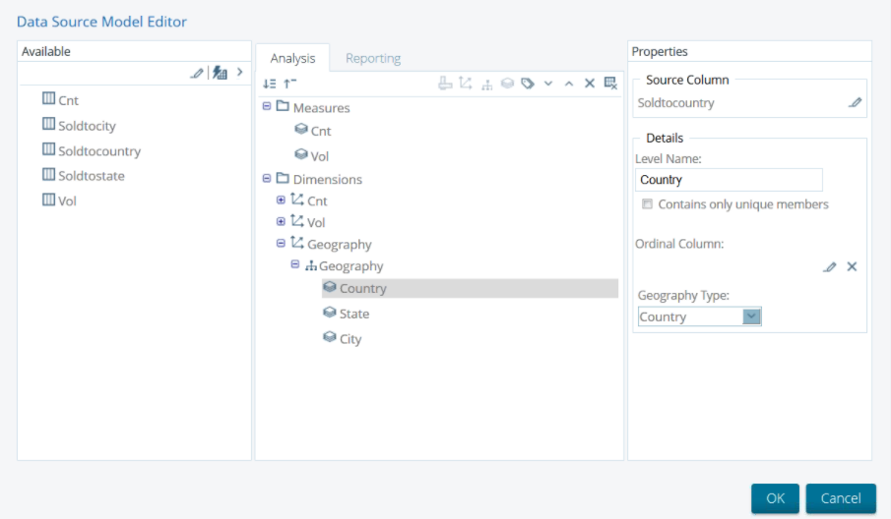
Data Source Wizard

Slide 43
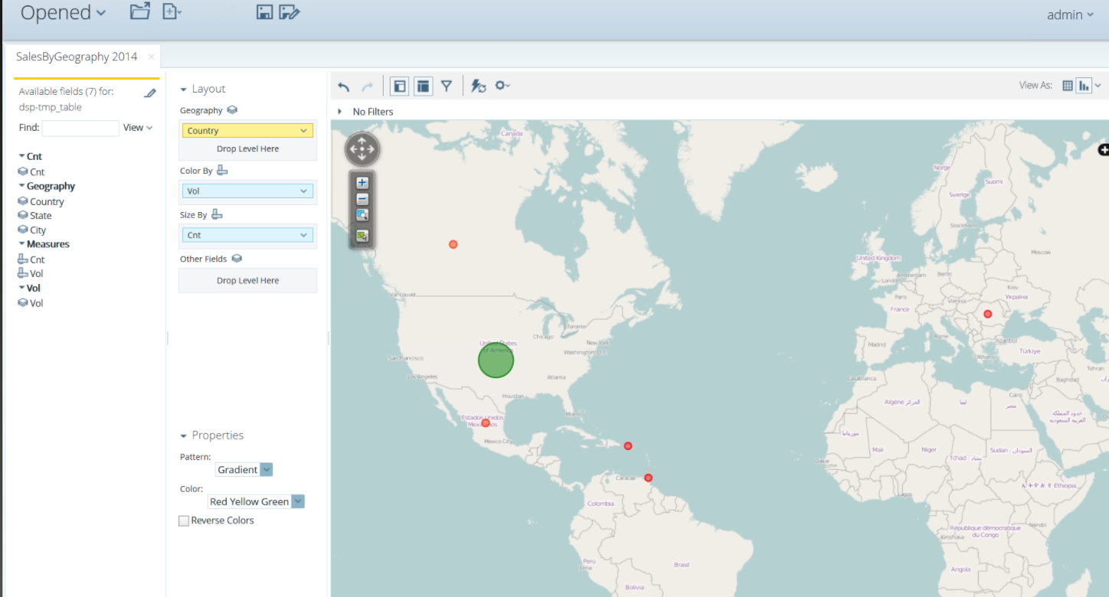
Geo-mapping
Notes:
Create a geographic map using the model with Google Maps visualizing two metrics:
Color dots by volume
Size dots by record count

Slide 44
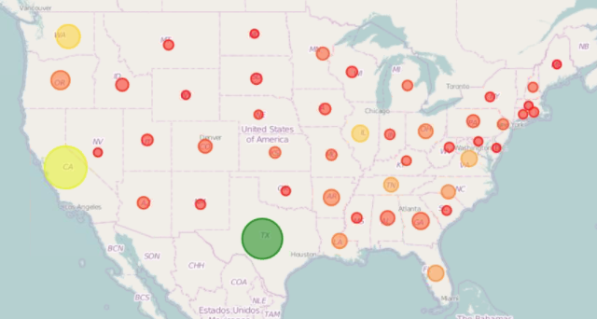
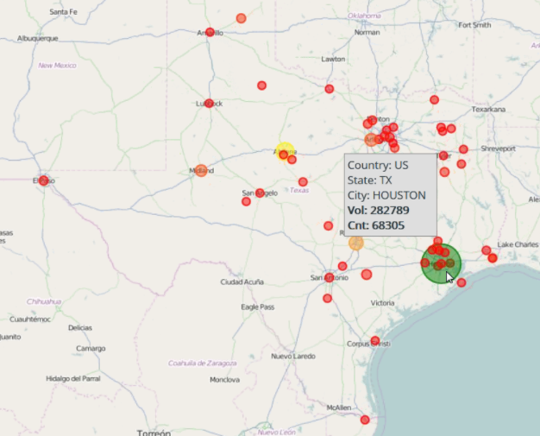
Drill Down
A Country > State > City … hierarchy was created in the model to support drill down.

Slide 45
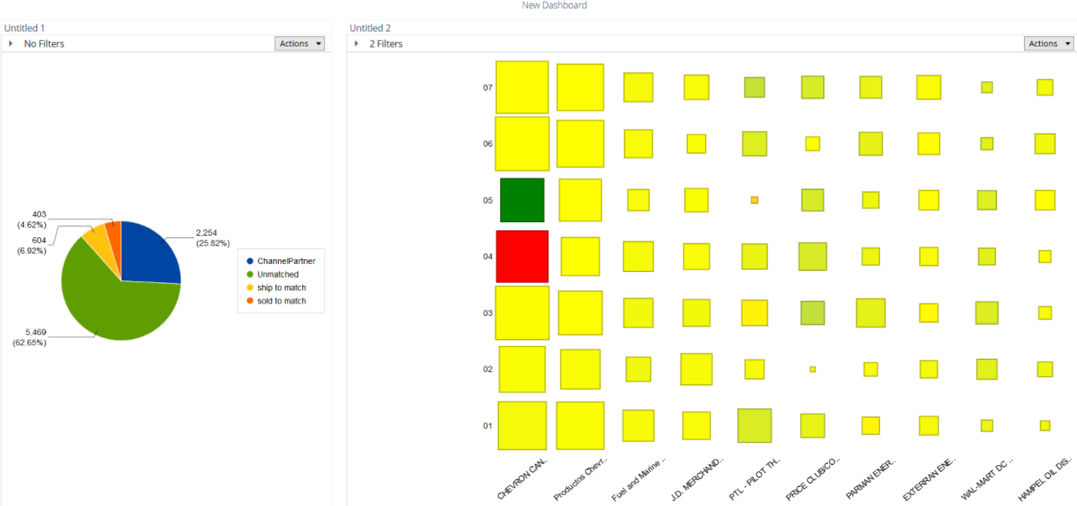
Dashboarding
We put together a simple dashboard showing two of our visualizations using the web-based dashboard designer in 5 minutes.
Single-sign-on (SSO) and Active Directory roles can be used to control access.

Slide 46
Questions and Discussion

Slide 47
Thank You

